Slide 1

BUSINESS
项目汇报
The user can demonstrate on a projector or computer, or print the presentation and make it into a in a wider field
汇报人：筱宸

Slide 2
01
02
03
04
CONTENTS
项目背景介绍
项目模板功能
项目功能展示
项目总结
The user can demonstrate on a projector or computer, or print the presentation and make it into a in a wider fieldThe user can demonstrate on a projector or computer, it into a in a wider field

Slide 3
01
项目背景介绍
The user can demonstrate on a projector or computer, or print the presentation and make it into a in a wider field

Slide 4

01
项目介绍
The user can demonstrate on a projector or computer
娱乐分享博客
本博客为新闻娱乐资讯，用于进行新闻娱乐交流评论时事
以及解决内部少量技术交流问题
项目技术点
Django
MySQL / Redis
Jquery / CSS
Bootstrap
Vue

Slide 5
02
项目模板功能
The user can demonstrate on a projector or computer, or print the presentation and make it into a in a wider field

Slide 6

02
项目模板功能
The user can demonstrate on a projector or computer
登录/注册
登录/注册
首页展示
首页展示
图像验证，短信验证
状态保持 Cookie
分类展示，分页展示，轮播图播放广告
发布博客/博客详情
忘记密码/个人中心
数据库添加
博客展示，评论展示
图像验证，短信验证
头像上传，更改个人信息
发布博客/博客详情
忘记密码/个人中心

Slide 7
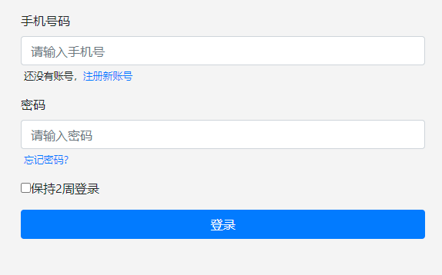
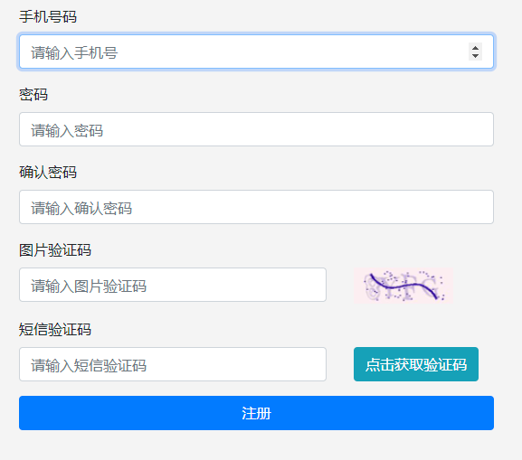
02
项目模板功能
The user can demonstrate on a projector or computer
登录
The user can demonstrate on a projector or computer
注册/忘记密码
The user can demonstrate on a projector or computer

Slide 8
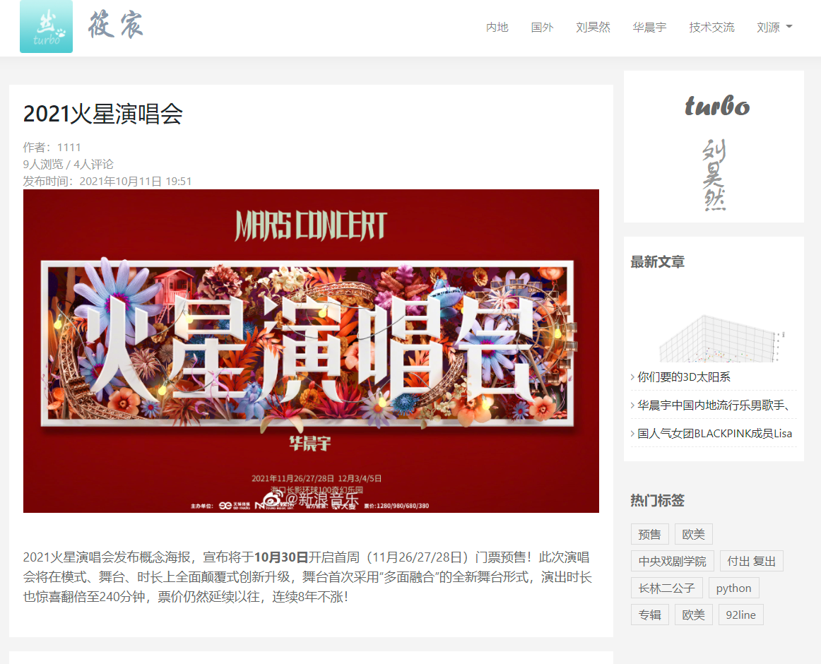
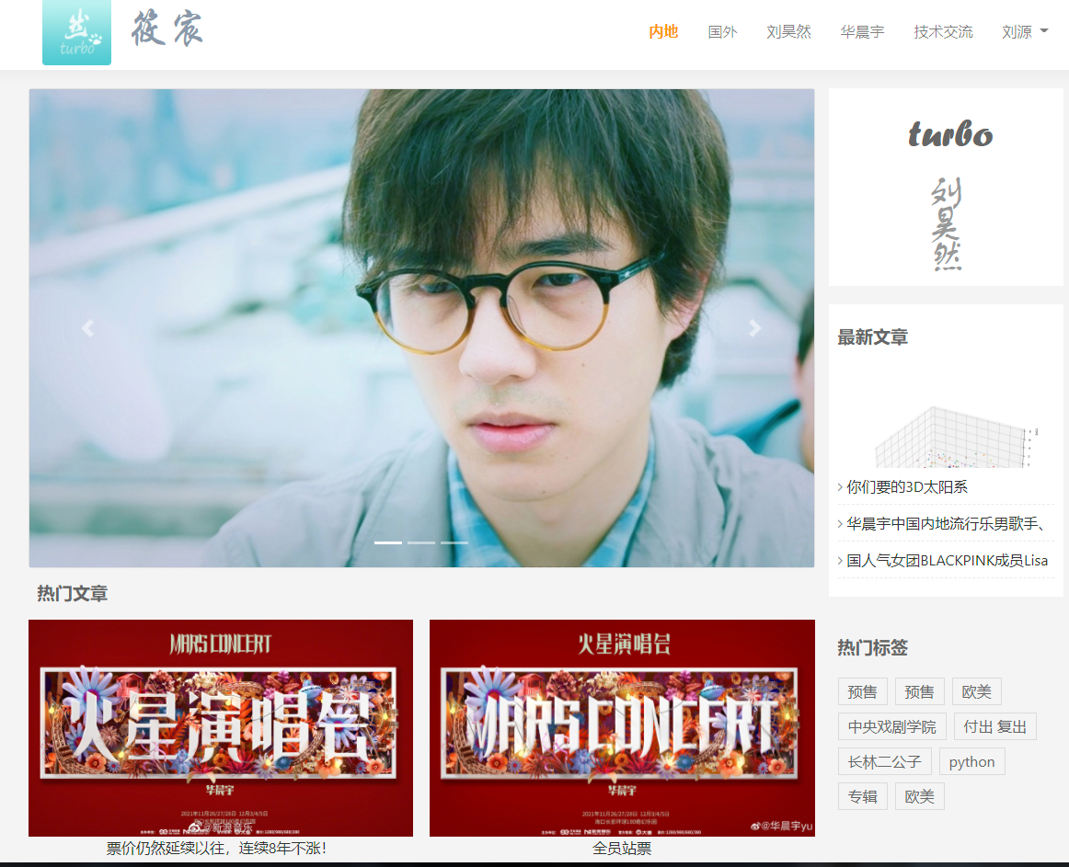
02
项目模板功能
The user can demonstrate on a projector or computer
首页
博客详情
The user can demonstrate on a projector or computer
The user can demonstrate on a projector or computer

Slide 9
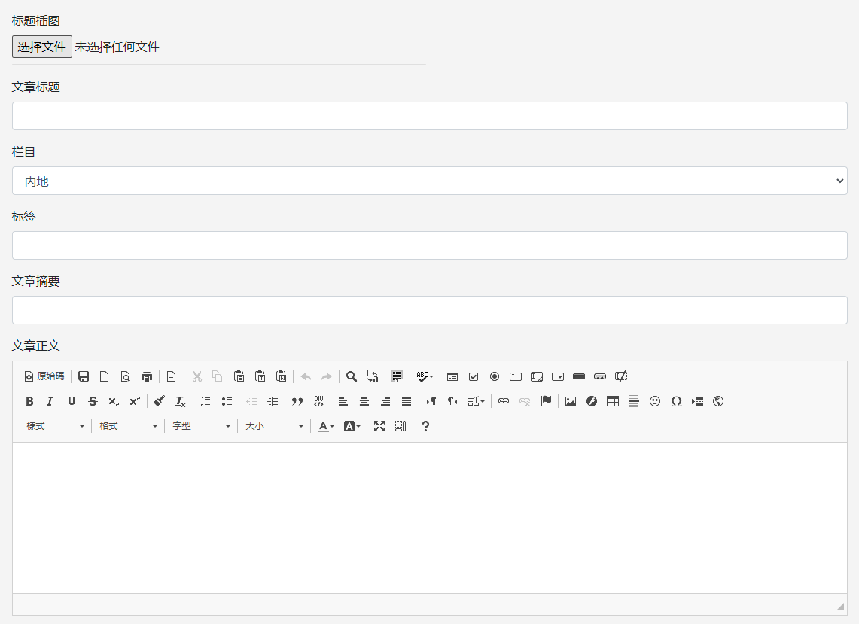
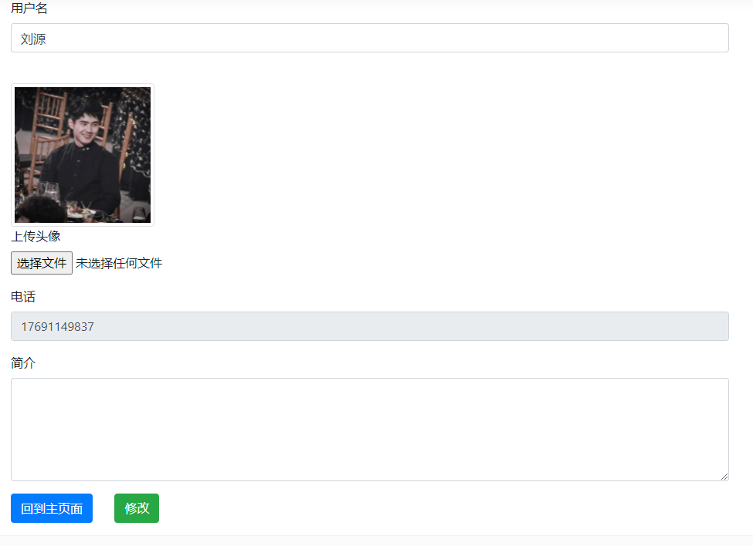
02
项目模板功能
The user can demonstrate on a projector or computer
写博客
个人中心
The user can demonstrate on a projector or computer
The user can demonstrate on a projector or computer

Slide 10
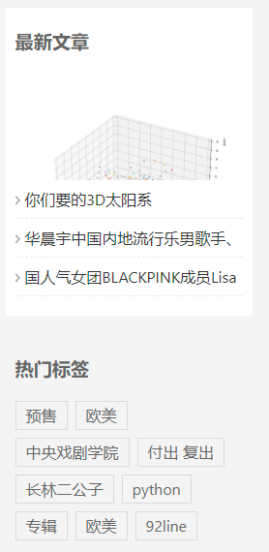
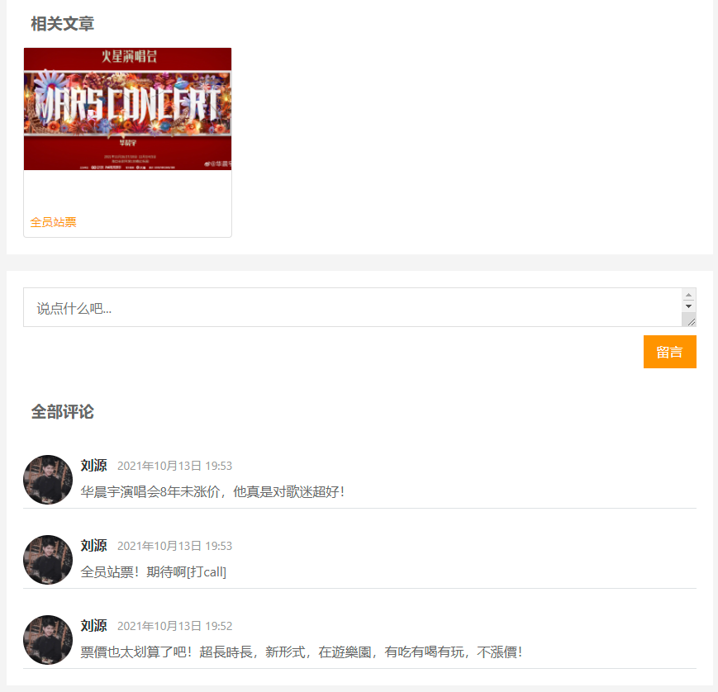
02
项目模板功能
The user can demonstrate on a projector or computer
最新文章/热门标签
相关文章/评论内容

Slide 11
03
项目功能展示
The user can demonstrate on a projector or computer, or print the presentation and make it into a in a wider field

Slide 12
04
项目
总结
The user can demonstrate on a projector or computer, or print the presentation and make it into a in a wider field

Slide 13


04
项目总结
The user can demonstrate on a projector or computer
收获
不足
学习到如何从都开始做一个项目，以及创建多应用进行结合，对django了解更加深刻
项目仍有不足大多数功能只有雏形，个别页面过于单调，对Jquery以及Vue用法不是很熟悉，MySQL数据库语法也略有生疏

Slide 14
04
项目总结
The user can demonstrate on a projector or computer
尽快了解Jquery/Vue的用法
将个别页面充实起来
熟悉MySQL语句
改进

Slide 15
BUSINESS
谢谢观看
The user can demonstrate on a projector or computer, or print the presentation and make it into a in a wider field
汇报人：筱宸

